Slide 1
Project Set-up
Prof. Dr. Dirk Riehle
Friedrich-Alexander University Erlangen-Nürnberg
ADAP A03
Licensed under CC BY 4.0 International
Notes:
It is Friedrich-Alexander University Erlangen-Nürnberg – FAU, in short.
Corporate identity wants us to say “Friedrich-Alexander University”.

Slide 2
Project Set-up Steps
Decide on topic for course project
Choose and install operating system
Choose and setup development environment
Register on GitHub and fork Wahlzeit
Get Wahlzeit running on your machine
Set-up debugging
Run unit tests

Slide 3
1. Course Project Decision
Decide on your project idea for Wahlzeit
  Give it a name, for example, “flowers”

Slide 4
2. Development Environment Set-up
Install and set-up Java IDE of your choice, e.g.
  IntelliJ IDEA: https://www.jetbrains.com/idea
  Eclipse: https://www.eclipse.org/ide
  Netbeans: https://netbeans.org
Install Java JDK 8 (or higher)
Install Git (command-line)
  If you need a GUI: https://git-scm.com/downloads/guis

Slide 5
3. GitHub Set-up
Register on github.com
  Go to https://github.com/dirkriehle/wahlzeit and fork the repository
Set-up continuous Integration with Travis CI
  Sign in with your GitHub account on https://travis-ci.org/
    Add your forked repository to the list of repositories Travis CI should check
    Ensure Travis CI is able to build your project

Slide 6
4. Wahlzeit Set-up
Clone your repository to create a local repository
  Ensure master branch is selected
Import the local repository into your IDE
Build and run Wahlzeit, try it at http://localhost:8080/wahlzeit
  On the command line, call “./gradlew appengineRun”
  A first build will take a while and may have intermediate steps

Slide 7
5. Debugging Set-up
Create remote Java debugging configuration
  Connection string is “localhost:8000”

Slide 8
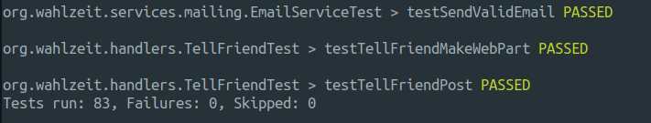
6. Unit Test Try-out
Use Gradle tasks to run unit tests
  “./gradlew test” runs all unit tests and provide a summary
  “./gradlew appengineRun” will also run test before starting the application

Slide 9
Thanks! Questions?
dirk.riehle@fau.de – http://osr.cs.fau.de
dirk@riehle.org – http://dirkriehle.com – @dirkriehle
DR

Slide 10
Credits and License
Original version
  © 2012-2018 Dirk Riehle, some rights reserved
  Licensed under a Creative Commons Attribution 4.0 International License
Contributions
  Andreas Bauer (2018)

